Slide 1



Indian Agricultural
Analysis
PowerBI Project
By:- Jyoti Saraswat

Slide 2

INTRODUCTION
This Project aims to conduct a comprehensive analysis of Indian agriculture, focusing on state-wise and year-wise data. The dataset provides detailed information on various crops, their areas, production and yields across different districts and years. The goal is to leverage Power BI to create interactive visualizations that uncover trends, patterns, and disparities in agricultural practices, enabling stakeholders to make informed decisions for sustainable farming and resource allocation.

Slide 3

Dataset Description:
The dataset encompasses a wide range of agricultural variables, including crop areas, production
quantities, and yields for different crops such as rice, wheat, sorghum, millets, pulses, oilseeds, sugarcane and more.
Learn More

Slide 4
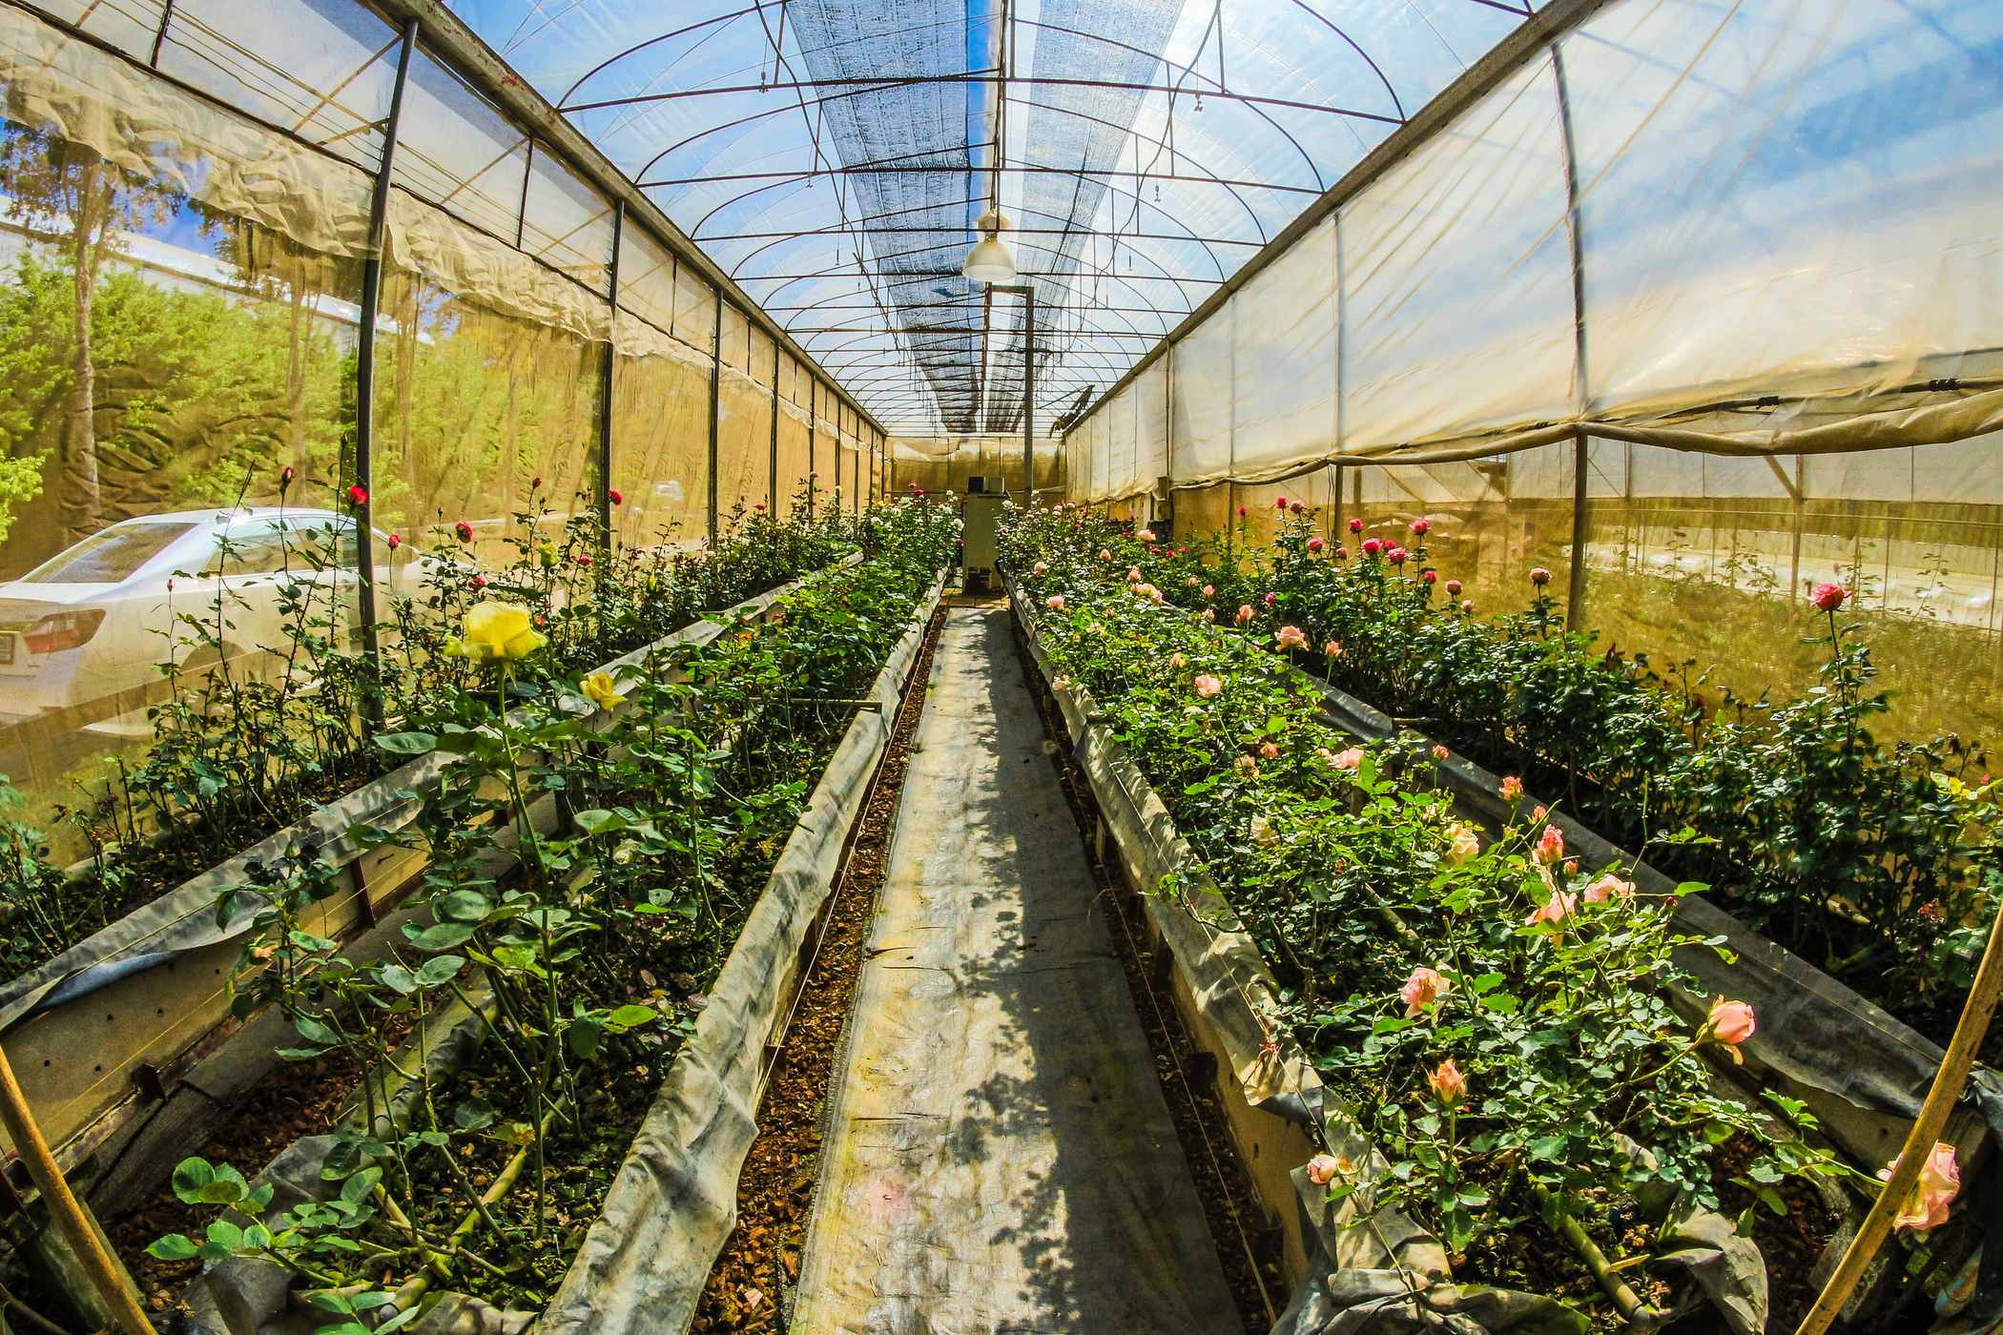
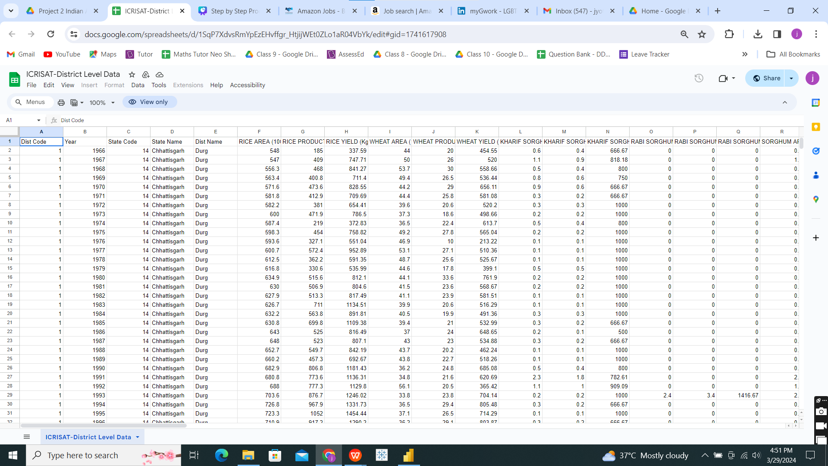
Data Overview
02

Slide 5
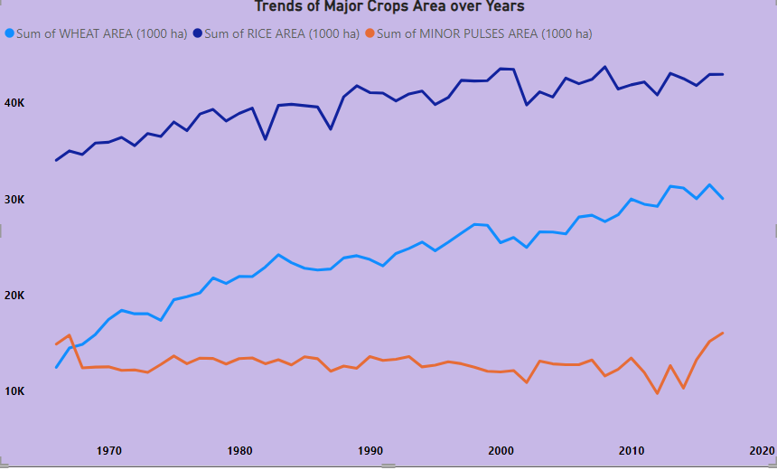
Crop-specific Analysis:
1) Trends in the cultivation of major crops (Wheat,Rice and pulses) focusing on changes in area over years
02

Slide 6

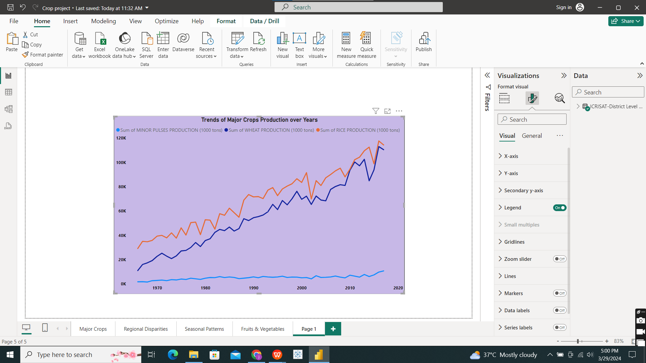
2) Trends in the cultivation of major crops (Wheat,Rice and pulses) focusing on changes in production over years
02
03
04

Slide 7
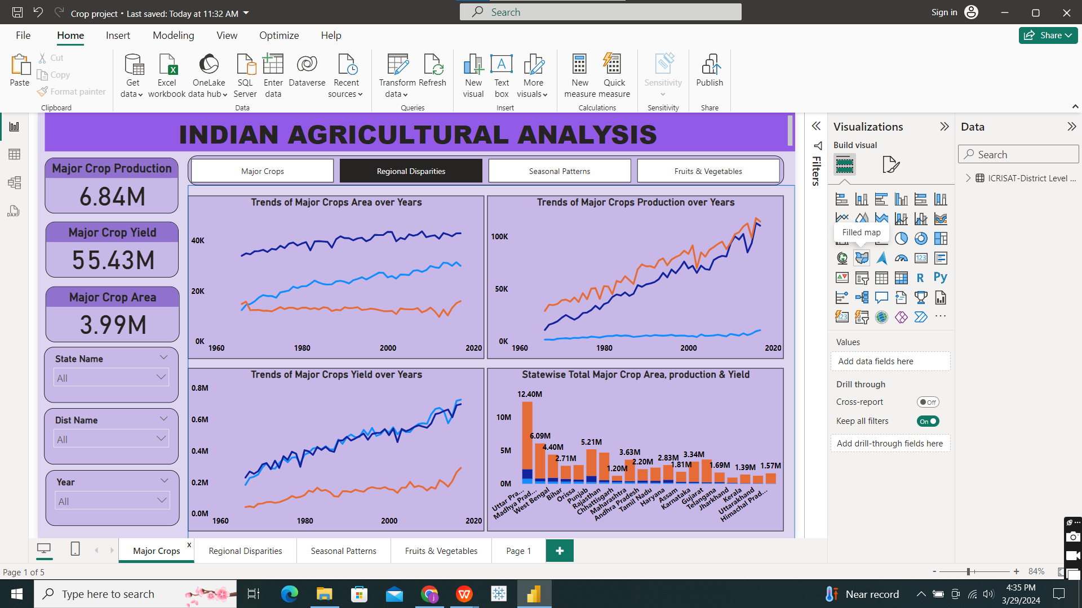
3) Trends in the cultivation of major crops (Wheat,Rice and pulses) focusing on changes in yield over years
02

Slide 8
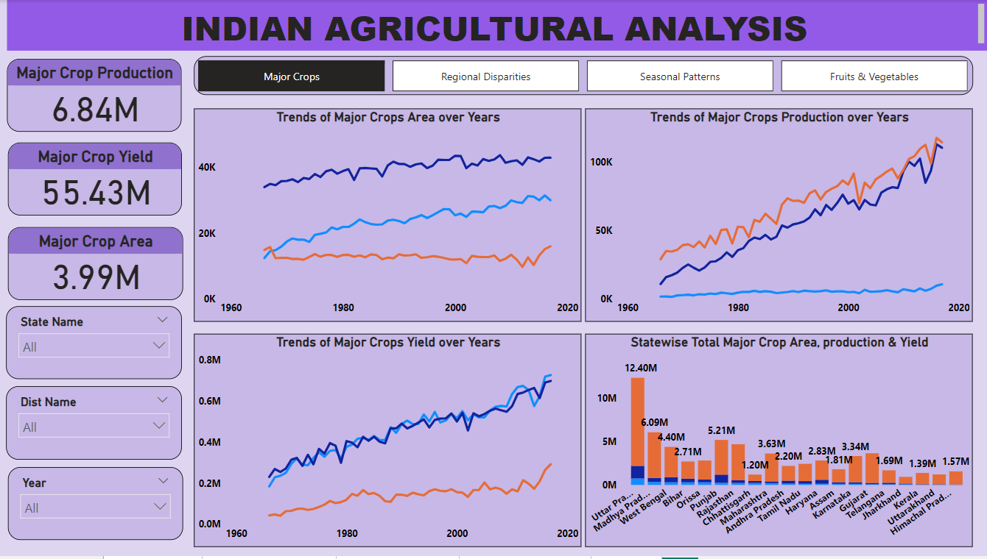
Trends in the cultivation of major crops
02

Slide 9

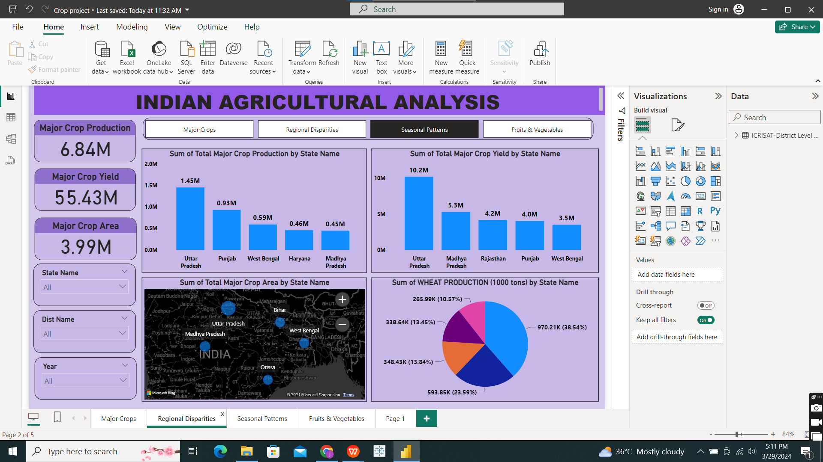
Regional Disparities:
Disparities and variations in agricultural practices and outcomes across different districts and states.

Slide 10

Regional Disparities:
Disparities and variations in agricultural practices and outcomes across different districts and states.

Slide 11
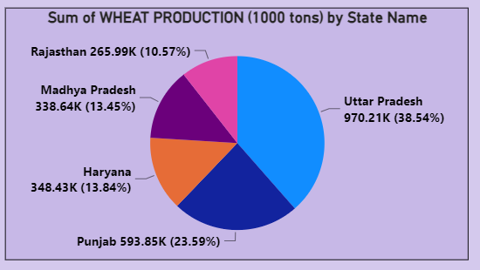
Regional Disparities:
Disparities and variations in agricultural practices and outcomes across different districts and states.

Slide 12
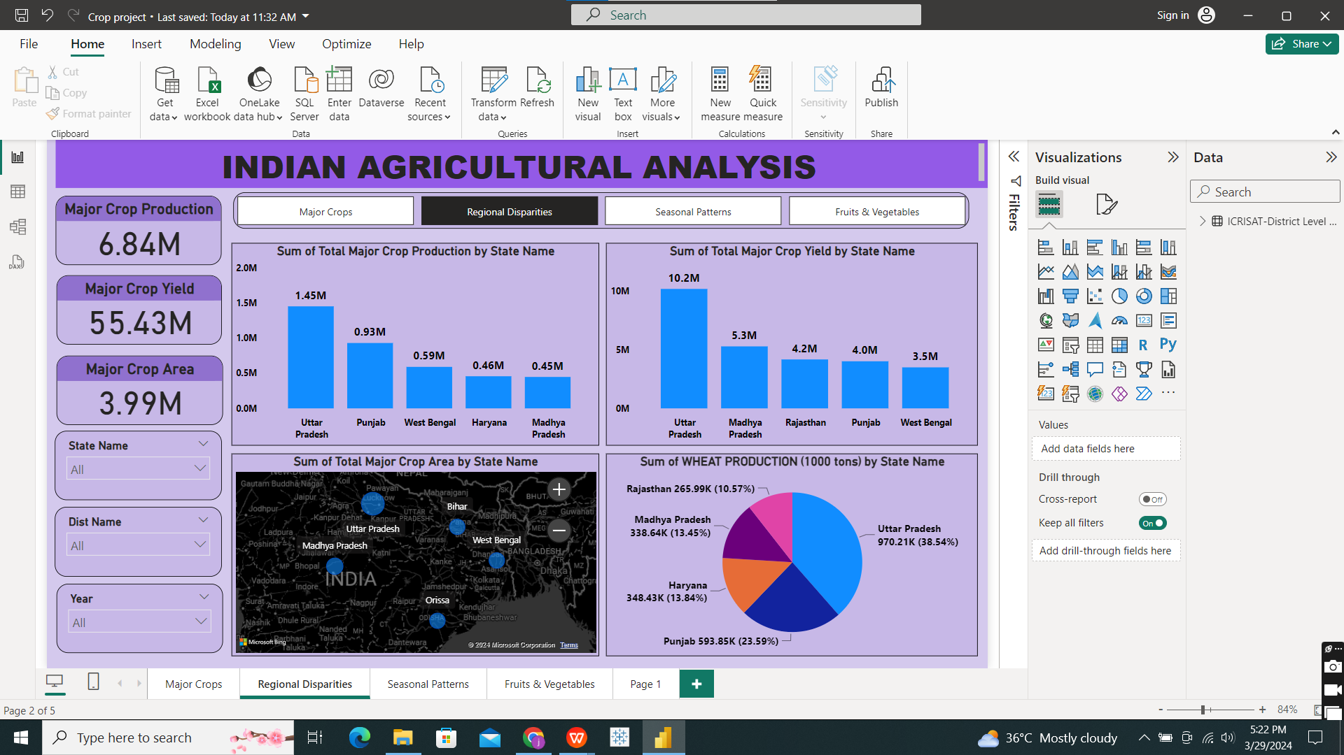
Regional Disparities:

Slide 13
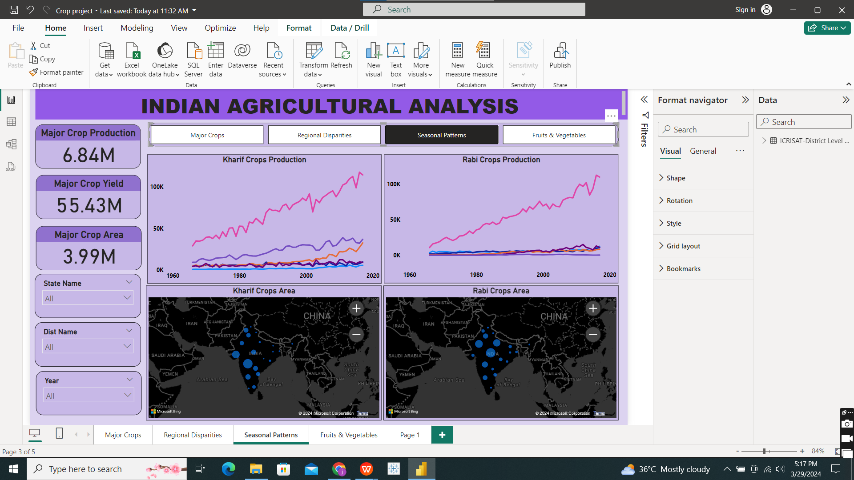
Seasonal Patterns:

Slide 14
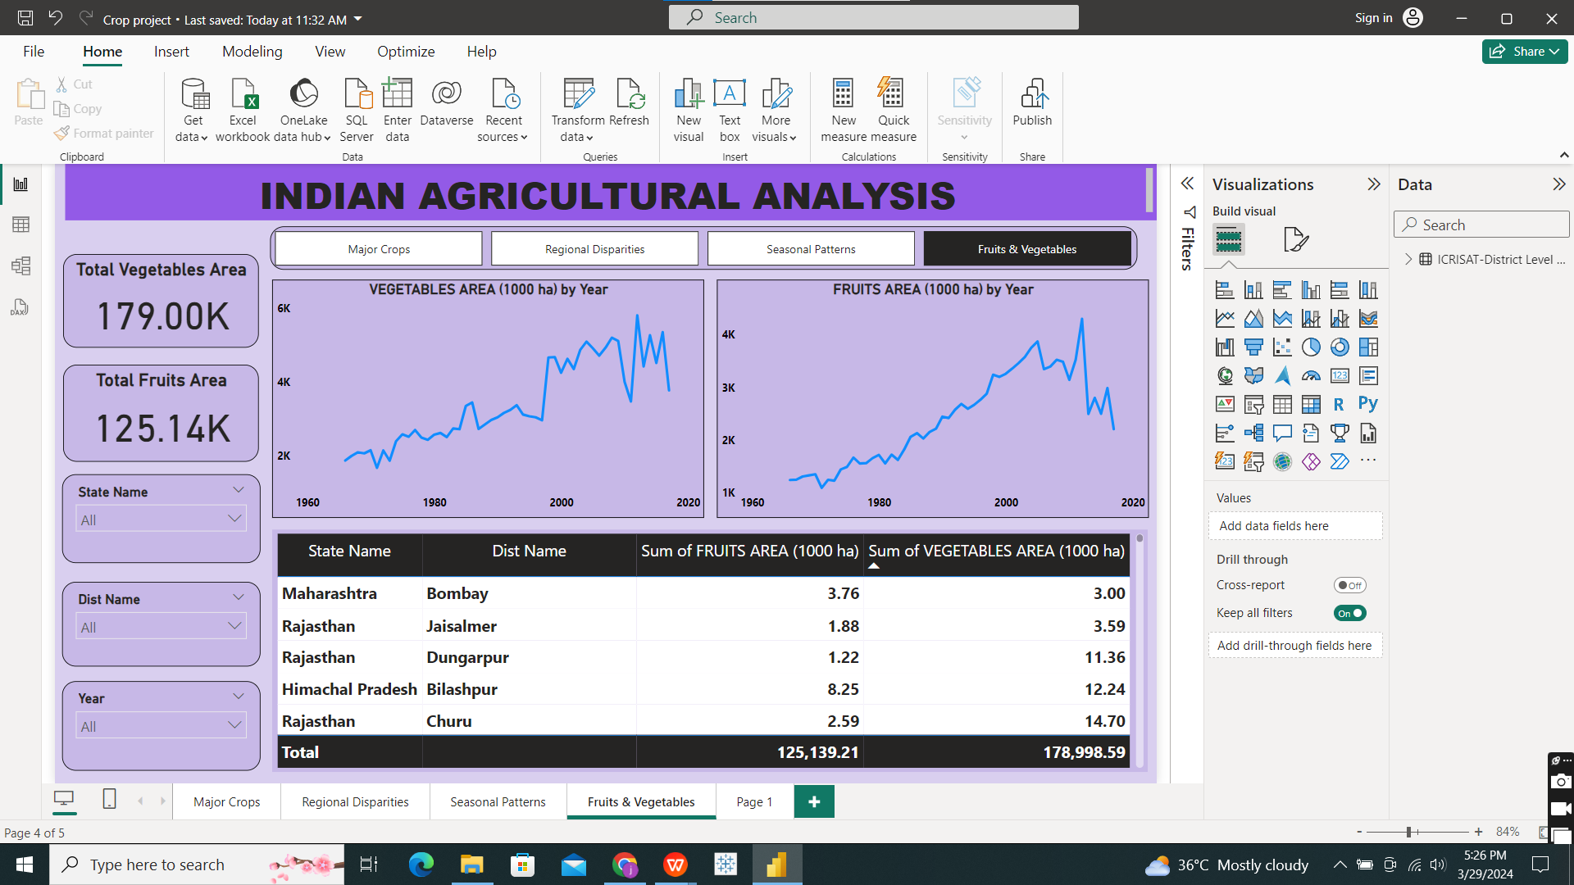
Fruits and Vegetables Analysis:

Slide 15

Recommendations for policymakers and stakeholders in the agriculture sector.
Diversify Crops: Instead of just growing rice, farmers should also consider growing wheat and pulses to balance risks and improve soil health.
Boost Wheat Yield: Focus on helping farmers grow more wheat since it produces more per kilogram than rice and pulses.
Support Top States: States like Uttar Pradesh, Punjab, and Madhya Pradesh should get extra help to keep up their good crop production. This means better irrigation, storage, and ways to sell their crops.
Rotate Crops Smartly: Encourage farmers to change what they grow each season to keep their land healthy. They should also be helped to know the best time to plant and harvest.
Help Fruit and Veggie Farmers: More support should go to farmers growing fruits and veggies, including better storage and ways to sell their produce.
Prepare for Climate Change: Teach farmers how to deal with weird weather and new challenges caused by climate change.
These steps can make farming in India more productive, sustainable, and able to handle changes in the weather.

Slide 16
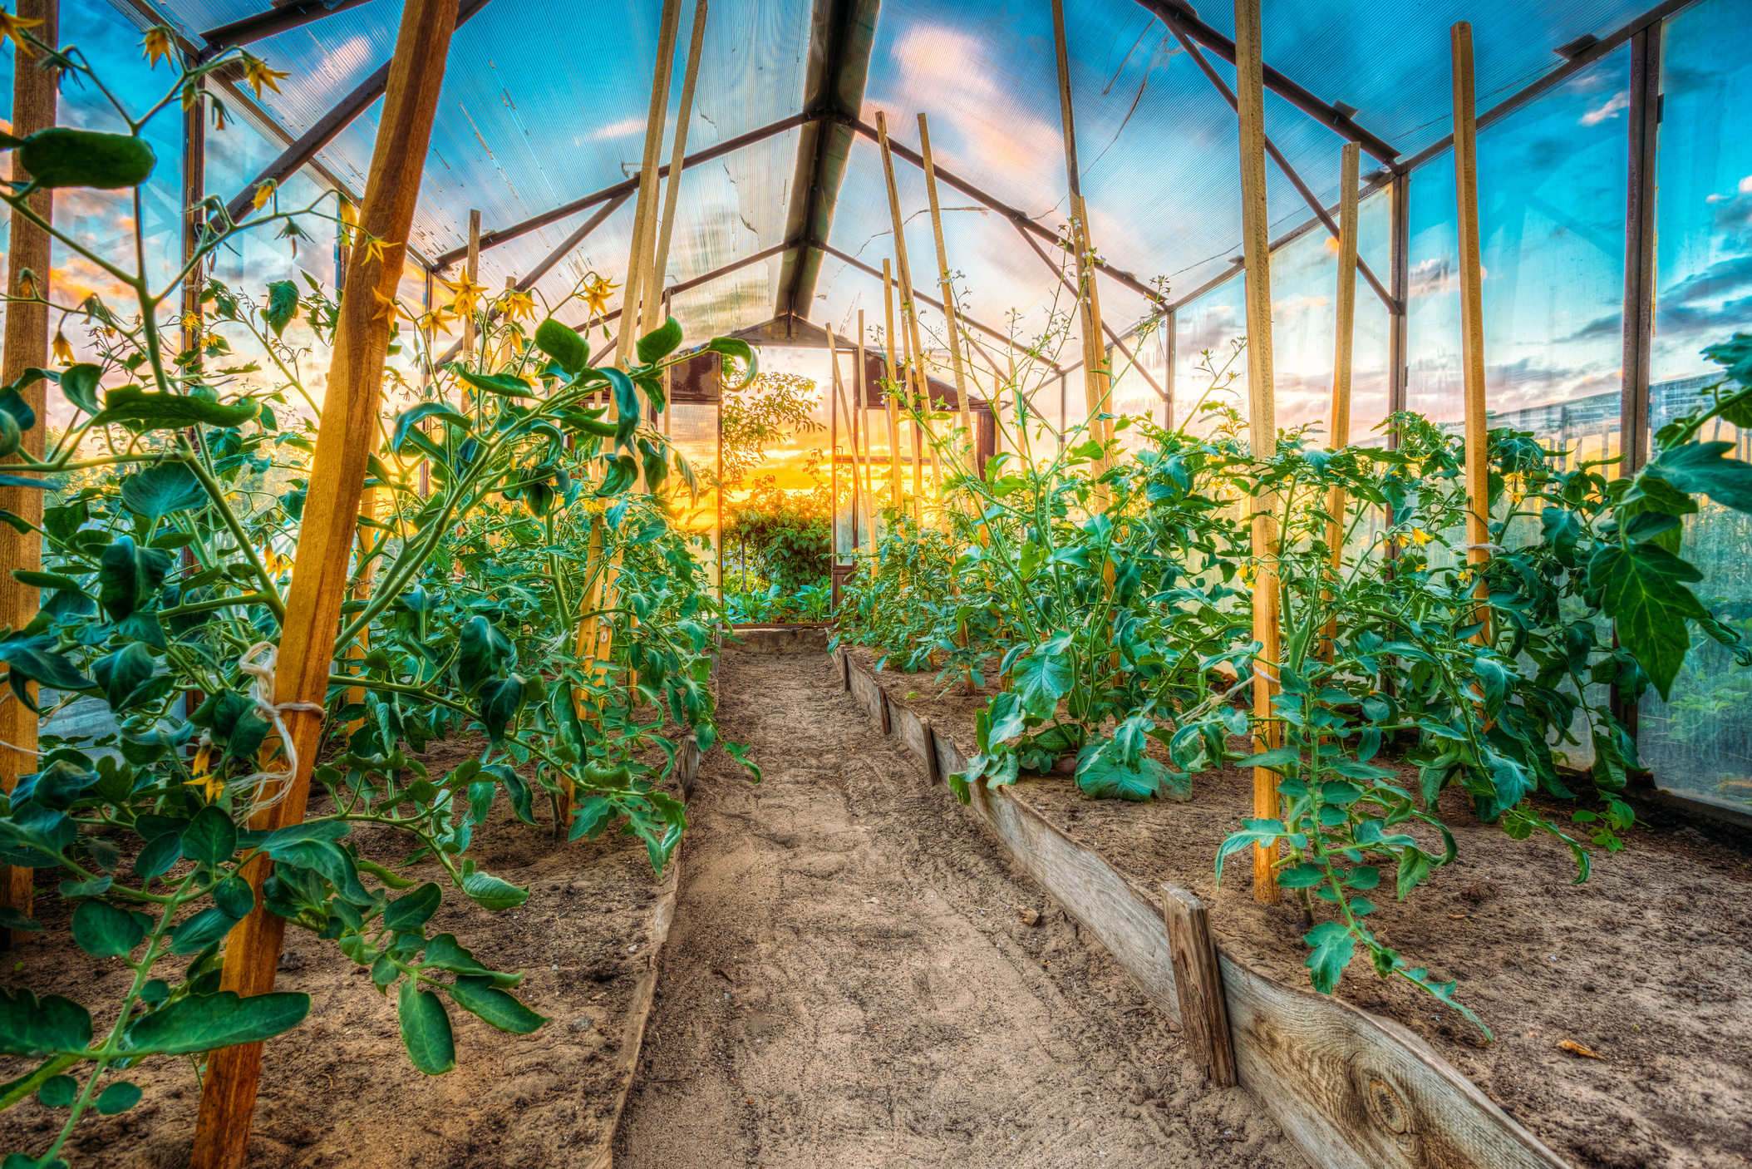
Thankyou

